Slide 1

Making it Real
Corey Buzzell
Principal Architect,
Microsoft Technology Center (MTC)

Slide 2
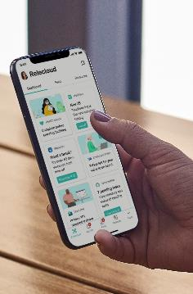
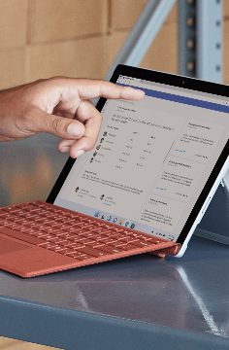








Microsoft Viva: employee experience platform for the hybrid era
SUITE OF TEAMS APPS
FKA Project Cortex
Aggregator, not LMS
Coming soon!
SharePoint
MyAnalytics, WpA
Viva Connections
Viva Insights
Viva Topics
Viva Learning
Ally.io
Culture and communications
Productivity and wellbeing
Knowledge and expertise
Skilling and growth
Objectives and key results

Slide 3
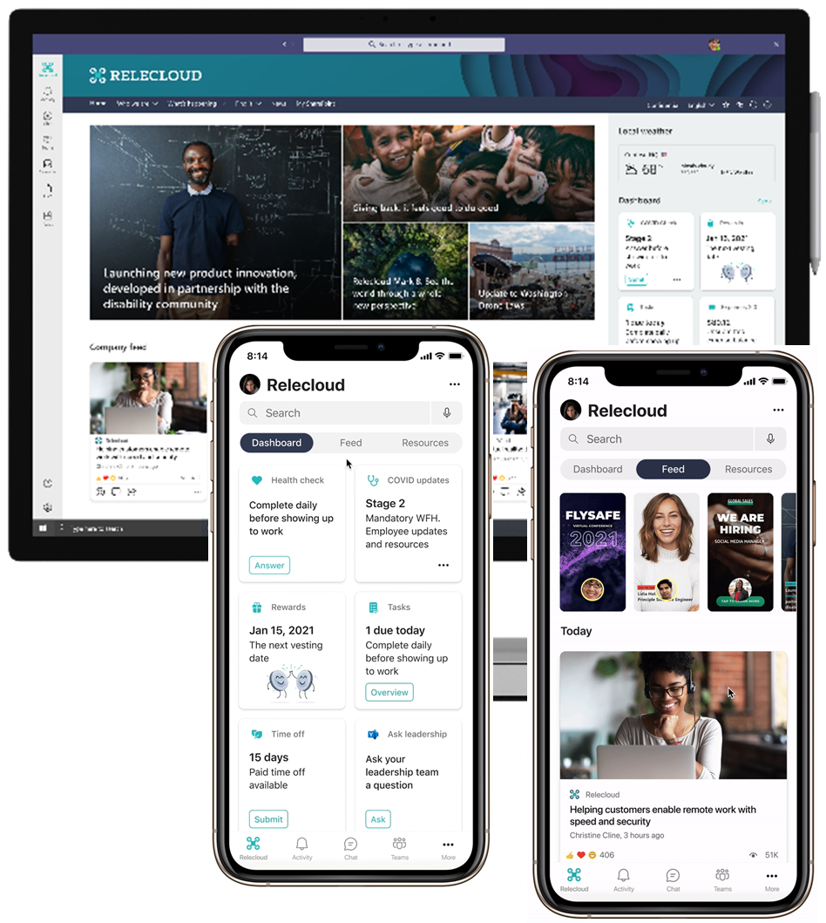
What is Viva Connections?
Your Intranet in Teams
Employee Dashboard
Includes configurable built-in cards
You can create customized cards
You can install cards created by partners
Targeted News feed
Driven by SharePoint Online, Yammer, Stream

Slide 4
Demo: Viva Connections

Slide 5
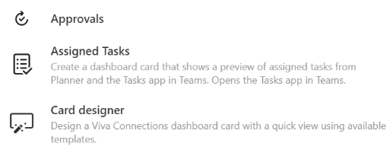
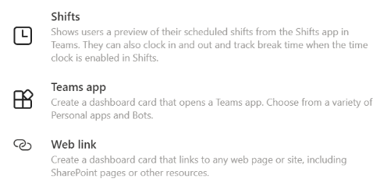

Dashboard cards currently available
BUILT-IN
Coming soon
Coming soon
PARTNERS
Coming soon
Coming soon
https://aka.ms/Viva/Connections/Partners

Slide 6
Dashboard card ideas
Pay & Benefits
IT
Facilities
Engagement
General
Paystub
Vacation
Incentive programs (stock)
Open/monitor ticket
Help w/ expense reporting
COVID/Crisis response
Food and dining menus
Facility request
New employee onboarding
Kudos
Ask leadership
FAQ
Staying up-to-date
Job tasks
Shifts & upcoming assignments/key tasks​
Tracking tasks, sales, and tickets​
Hand-off activities between shifts​
Job critical information​
Access to resources – handbooks, sales promos
Access to data – customer, sales
Know who is working, connect w/ experts​
Timesheets
Forms ​
Front Line Worker
Connect to expertise & knowledge
Stay informed & connected
Information Worker
People finder
Sales leads
Company holidays
Required training

Slide 7


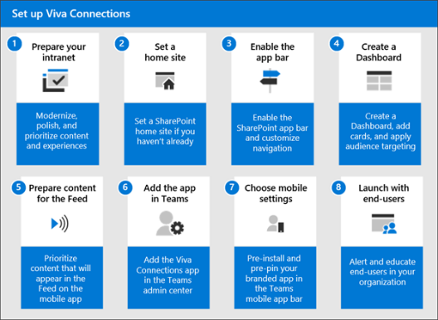
What do I need to use Viva Connections?
A modern site in SharePoint Online
Declare it the Home Site (you only get one)
Configure global navigation
Create a dashboard (just a page)
Publish news in SharePoint, Yammer, Stream
Add the Teams app (free, easy)
Deploy Teams app to employees
Adoption and Change Management
HR / Comms
IT Admin
https://aka.ms/Viva/Setup

Slide 8
Demo: Set up Viva Connections and Author Dashboard Cards

Slide 9
Get started today
Setup guide: https://aka.ms/Viva/Setup
SharePoint Lookbook: https://aka.ms/SharePointLookbook
Dashboard cards design guidance: https://aka.ms/Viva/Connections/Design
Partner integrations: https://aka.ms/Viva/Connections/Partners
Create your own dashboard cards: https://aka.ms/Viva/Connections/Create
Need more help or deeper conversation?
Fill out the survey at the end of today’s session to start this process

